Slide 1

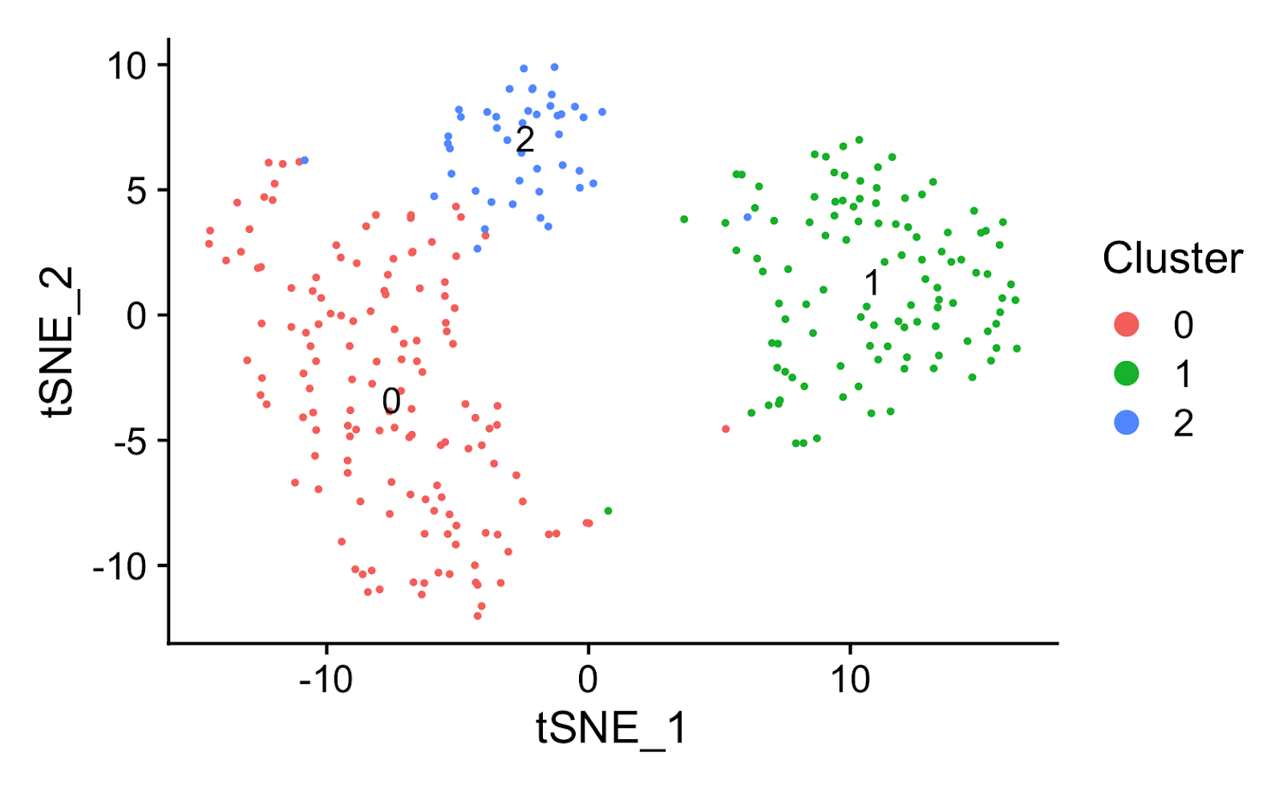
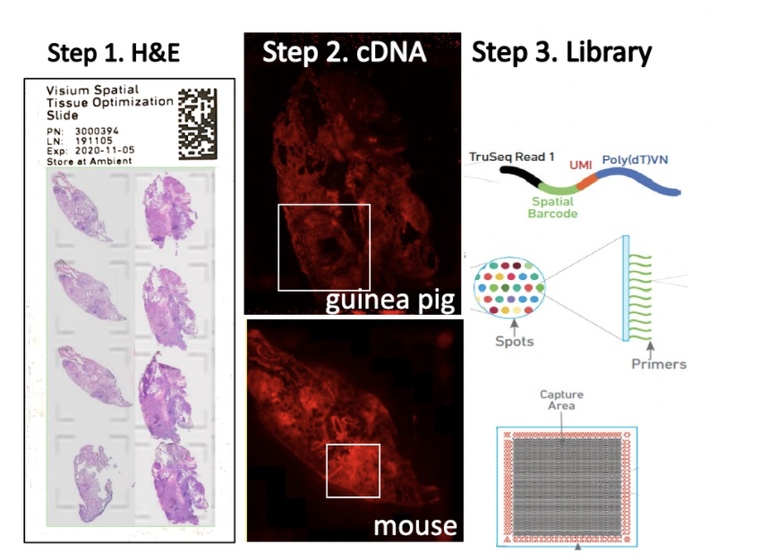
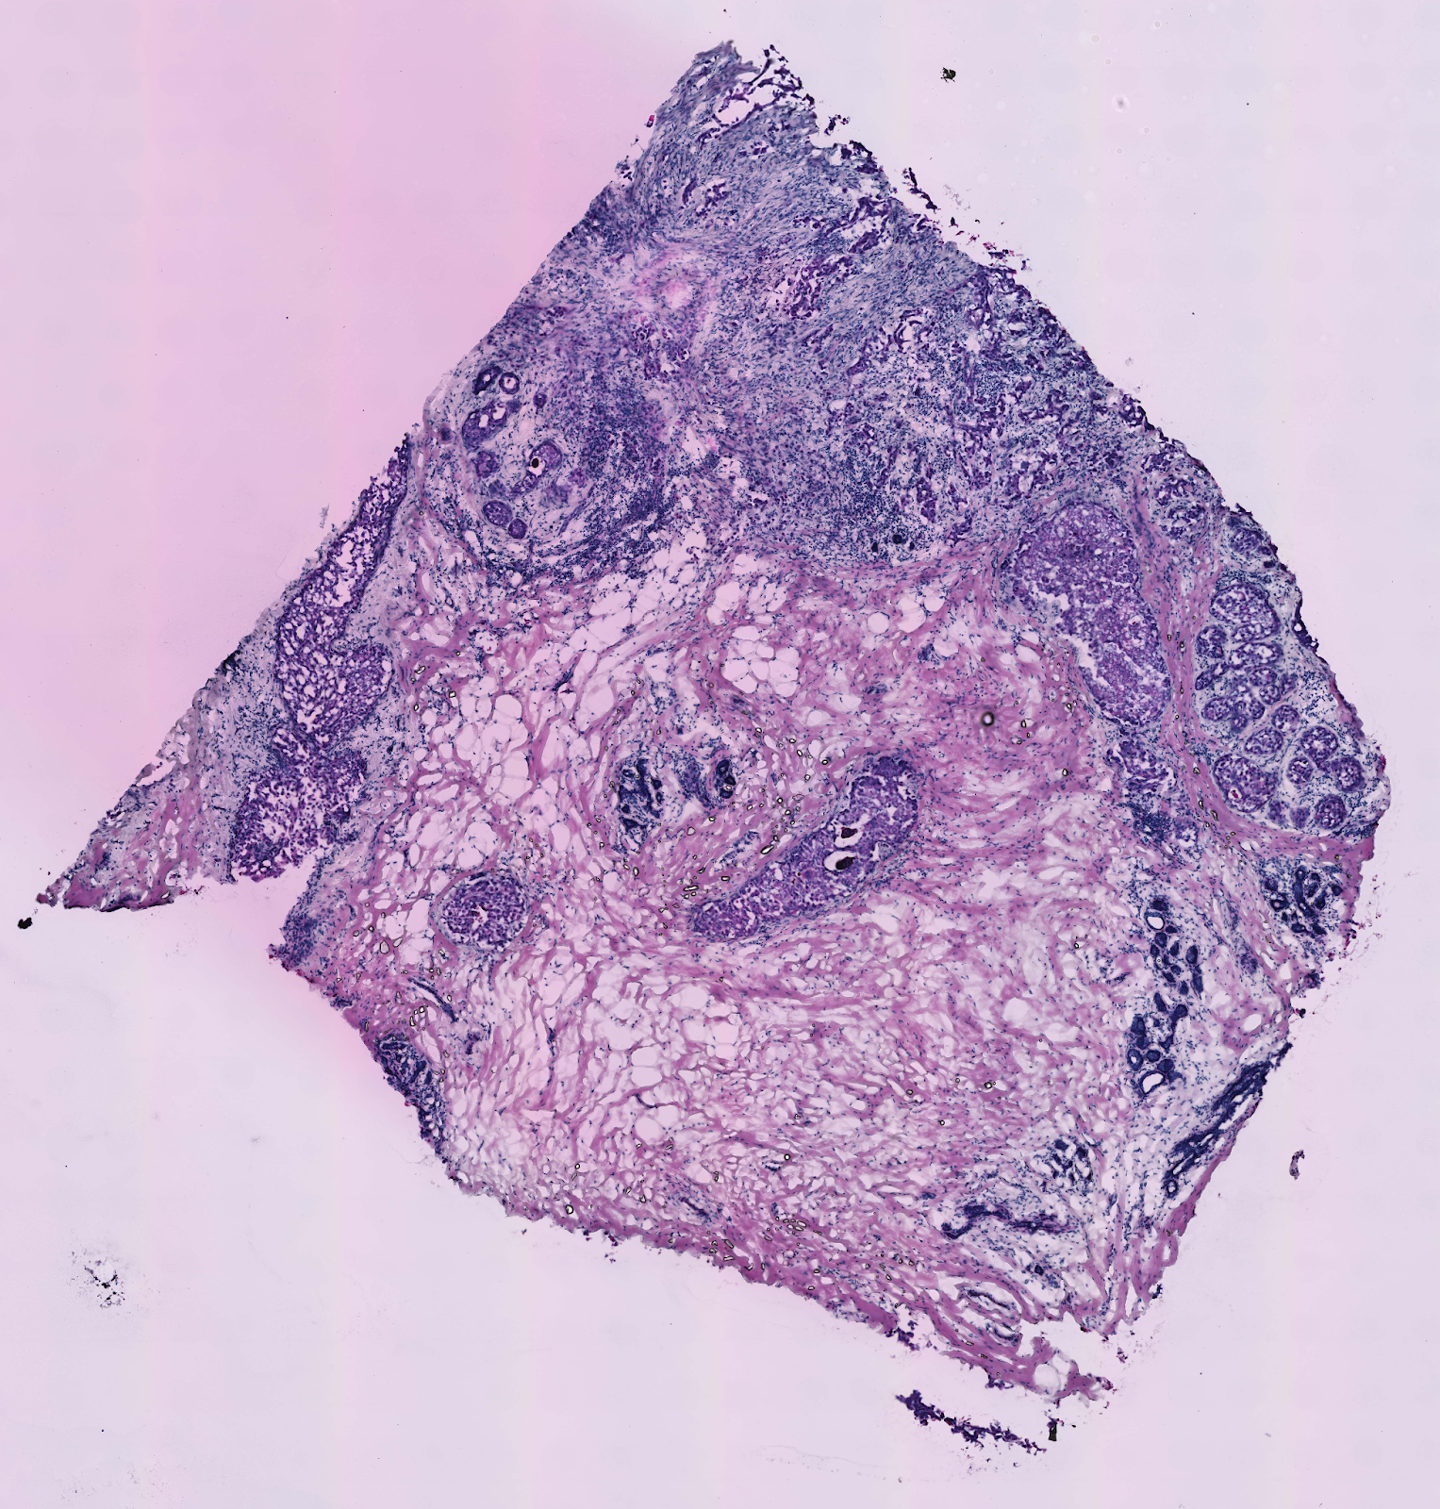
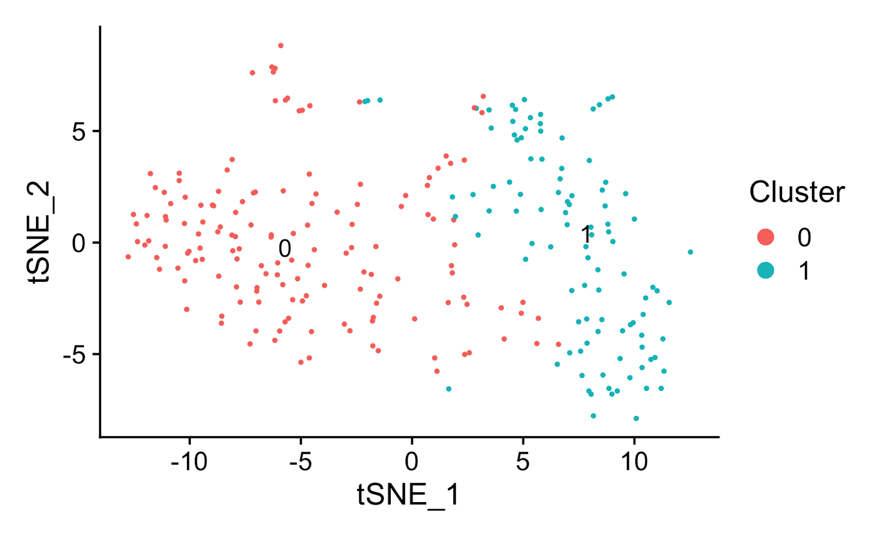
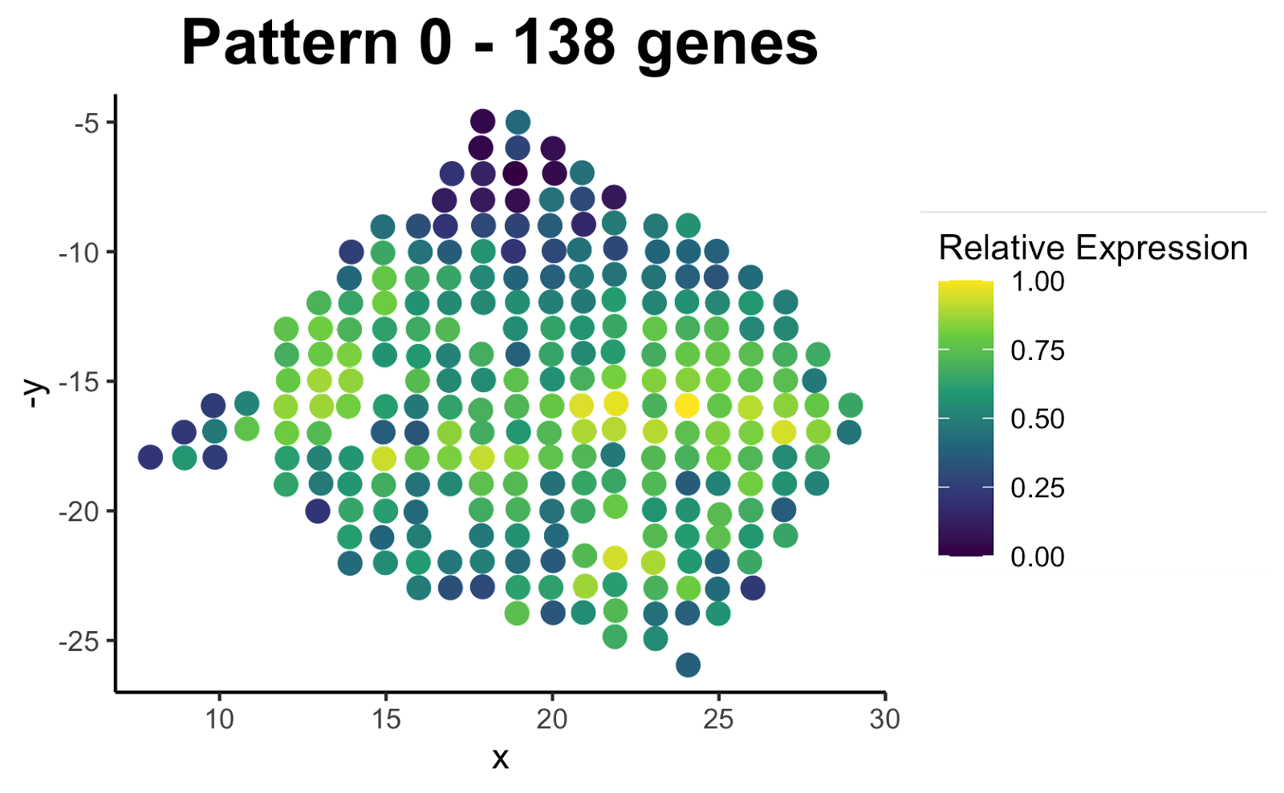
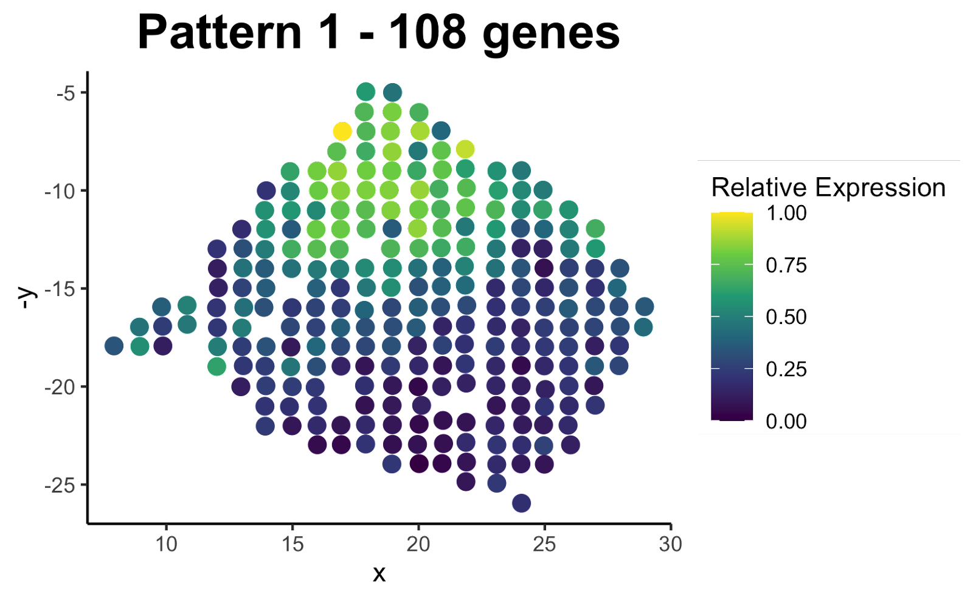
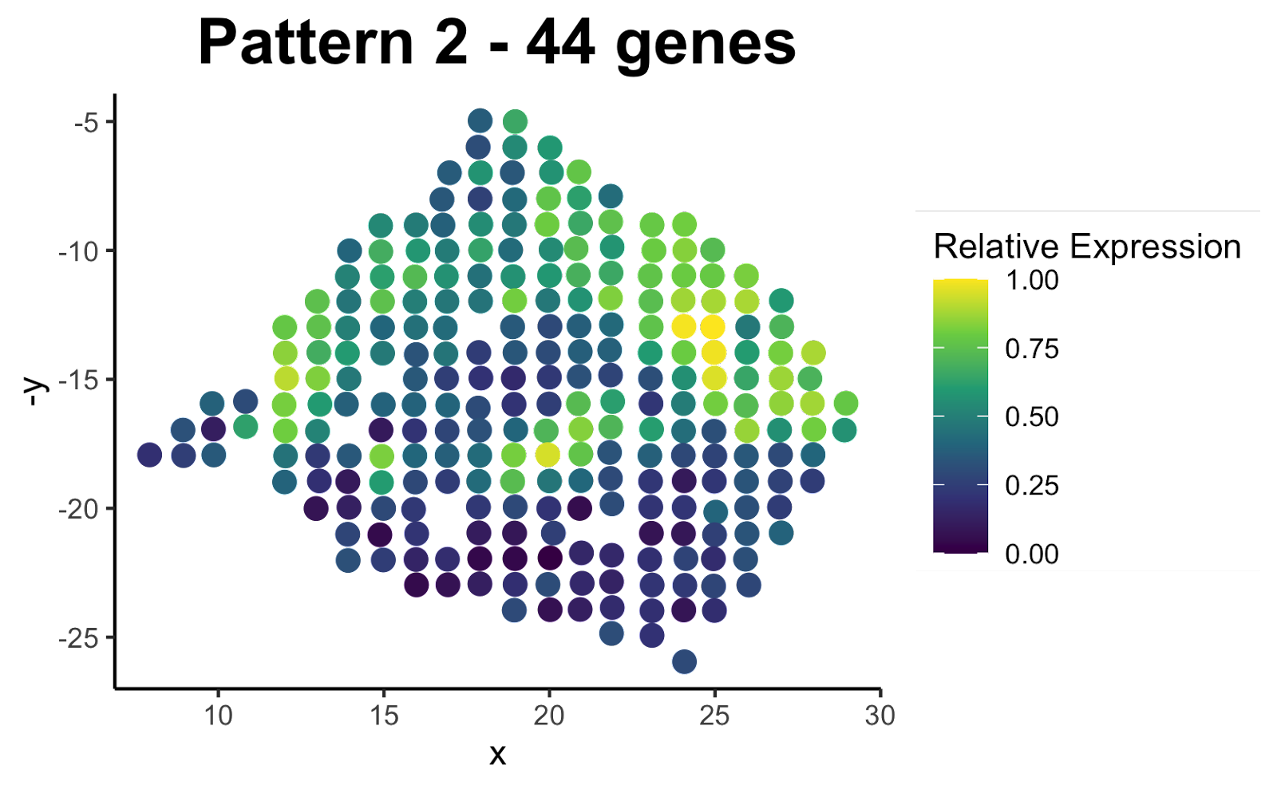
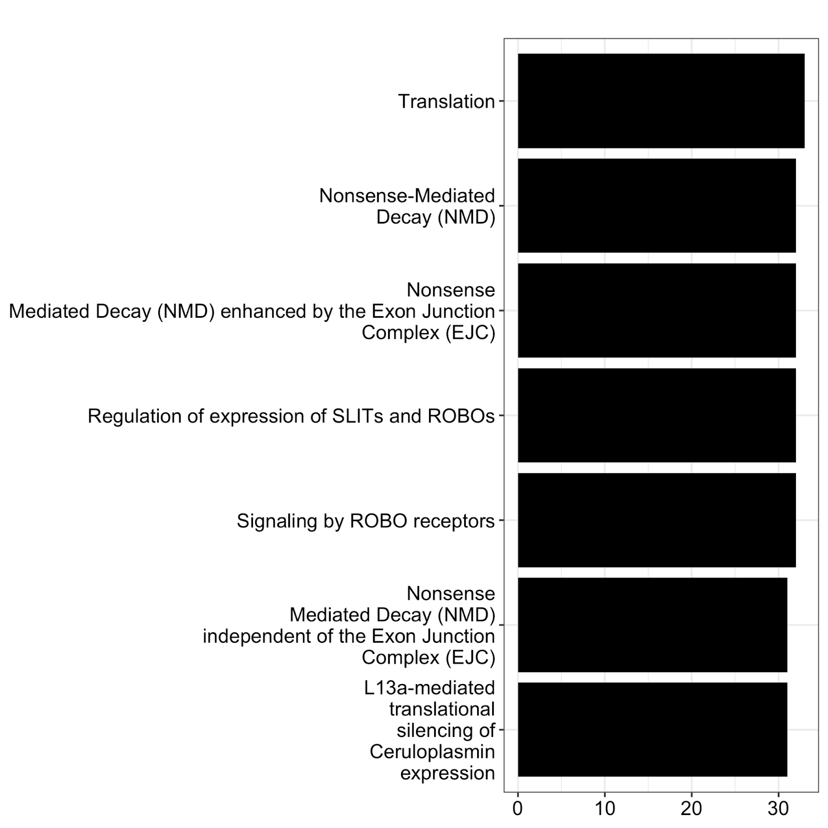
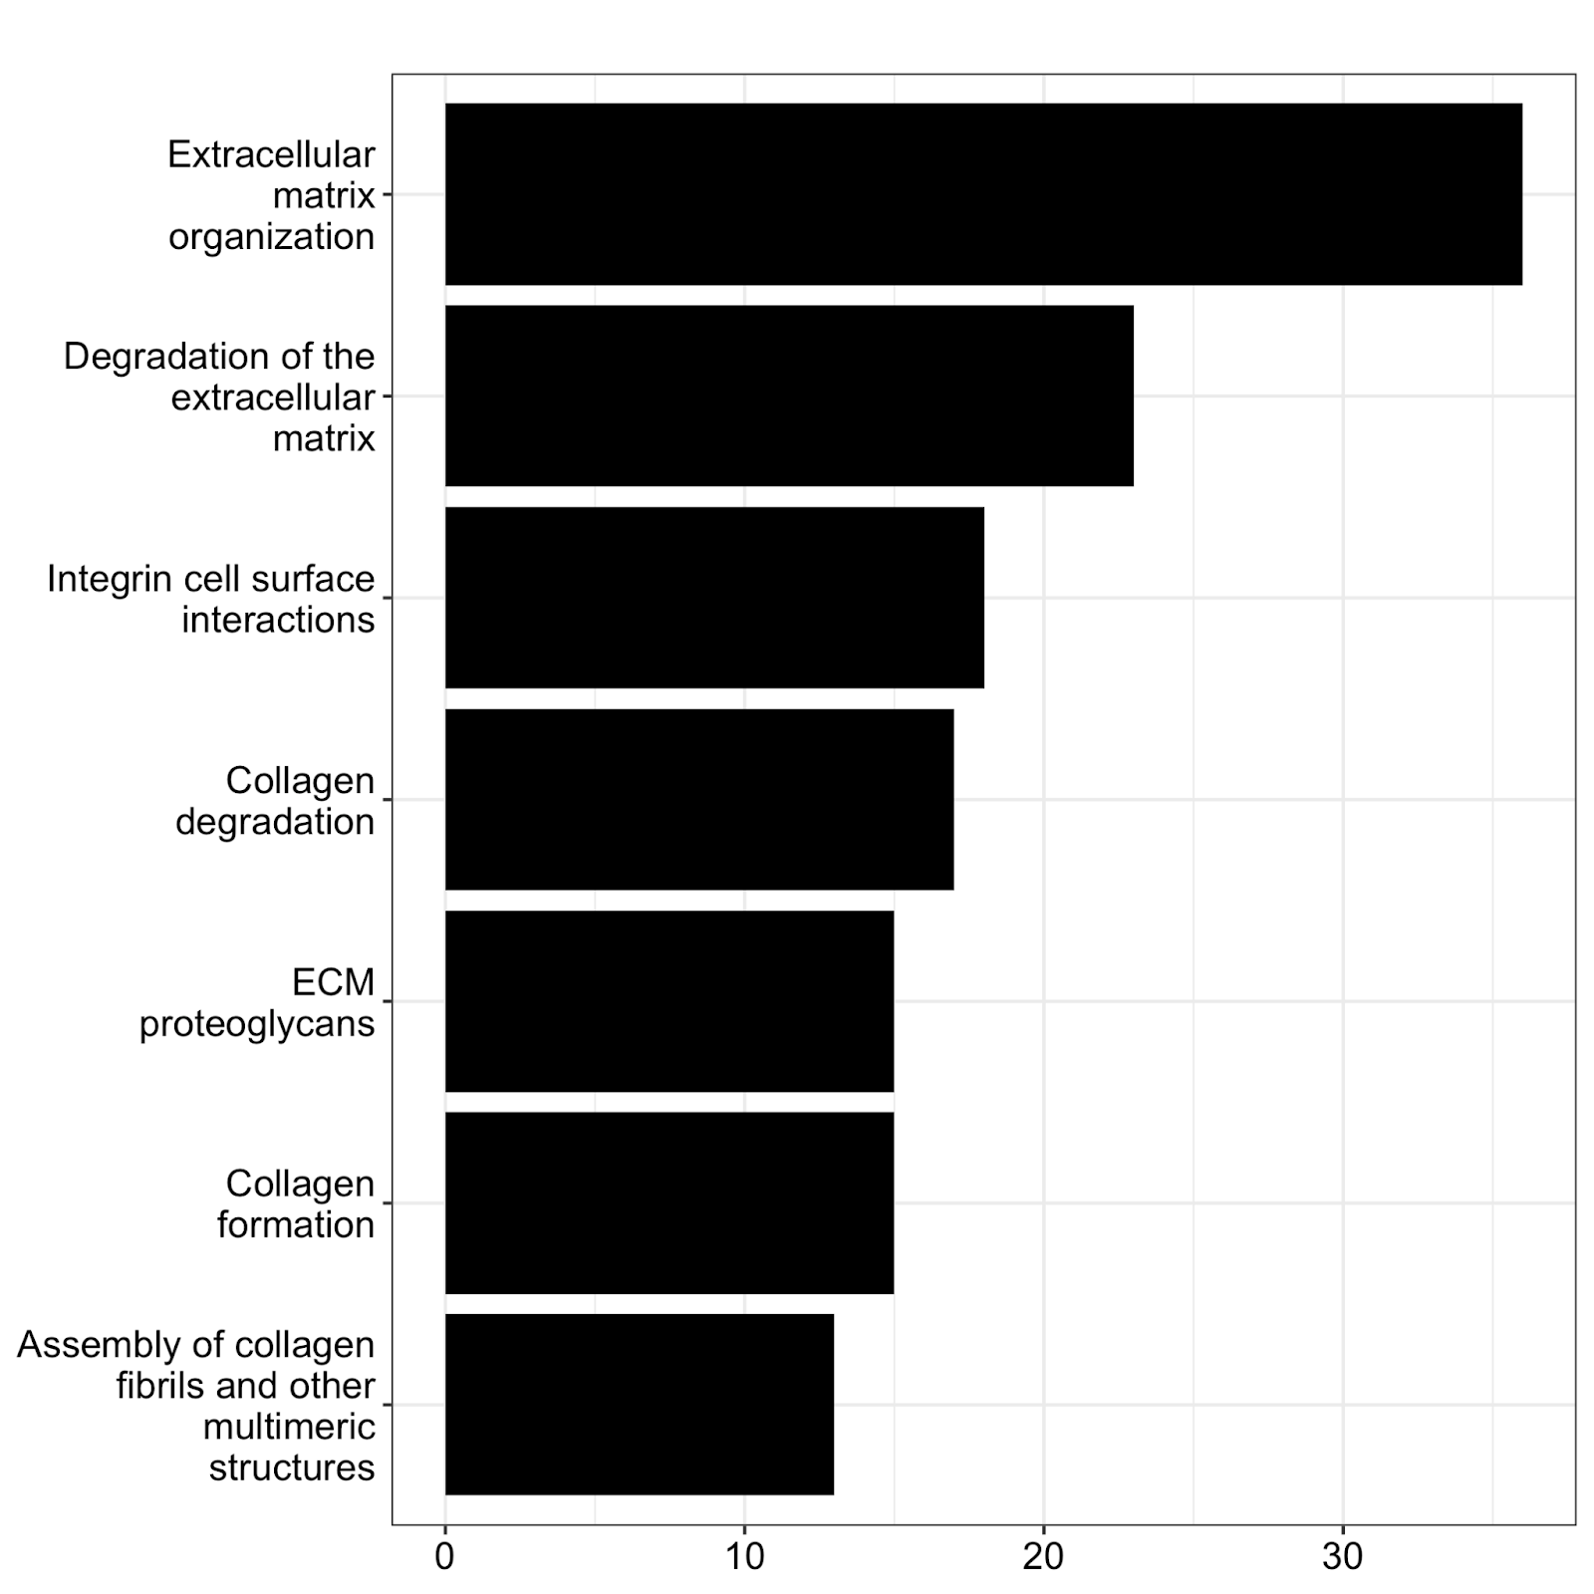
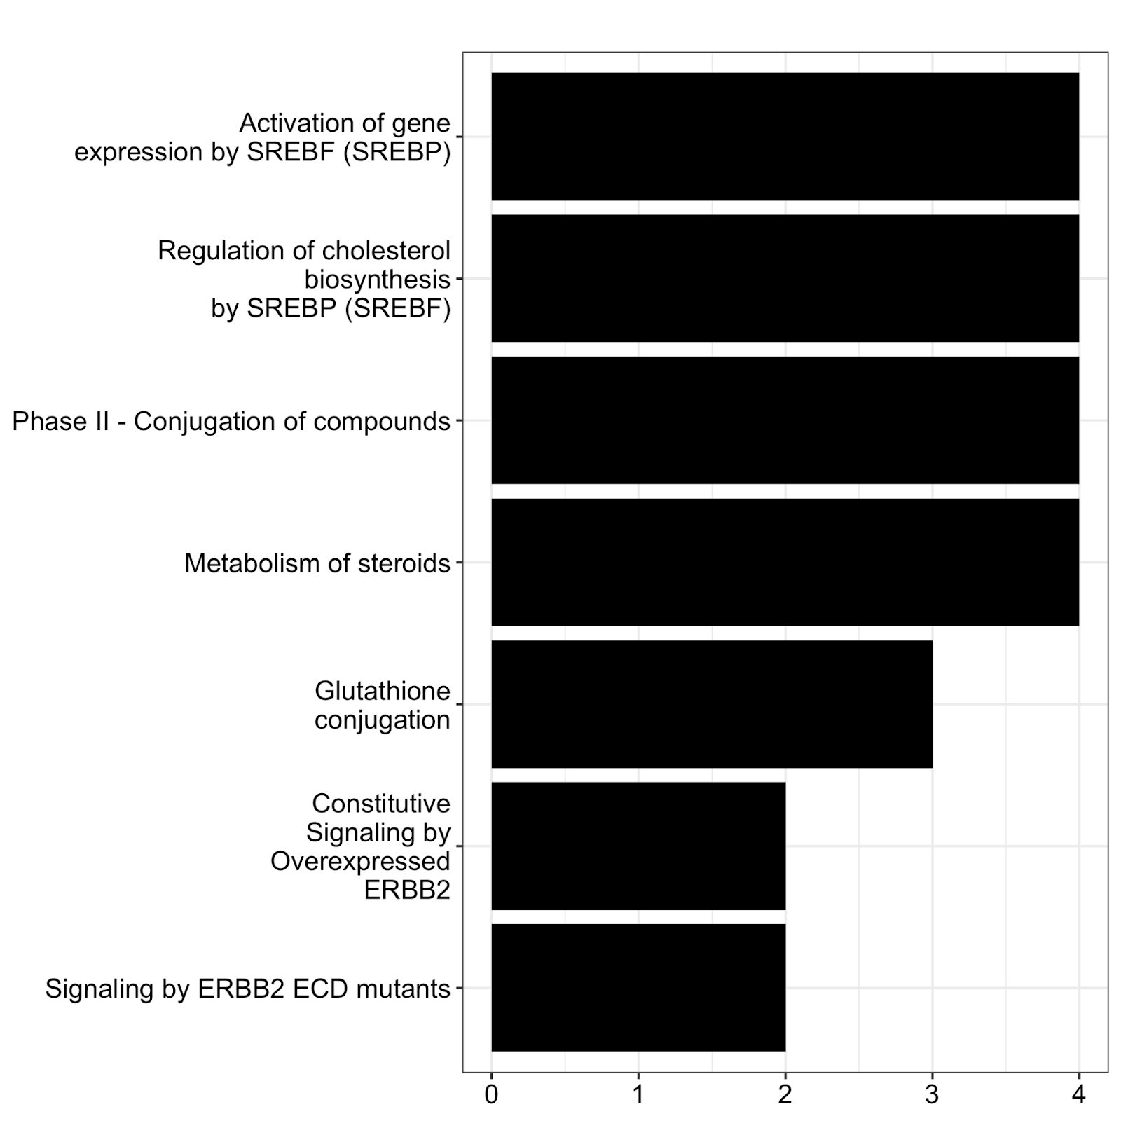
CR King, SK Cooper, BK Podell Department of Microbiology, Immunology and Pathology, Colorado State University, Fort Collins, CO
Resolving Resolution Hindrances in Spatial Transcriptomics
Background:
The tumor microenvironment is a complex structure formed of both cancer cells and non-malignant cells¹.
We need techniques that will allow us to study these cellular activities in the spatial context of the microenvironment.
Spatial transcriptomics is a novel technology that allows us to observe transcriptional landscape of the tumor microenvironment.
Most common approaches utilize the clustering of the spots themselves to identify regions of expression.
This is problematic in diseased tissue as cells tend to not form distinct regions of expression.
Here we utilize the clustering of genes to identify patterns of expression in a human breast cancer biopsy dataset, revealing important processes associated spatially with both invasive and noninvasive cancer containing tissues.
Model Design and Methods:
The data utilized in this study is from a previous study².
Genes expressed at a frequency of less than 1 in a million transcripts were removed before downstream analysis.
Gene-based clustering was performed in the R package Seurat³.
Significantly spatially variable genes were Identified using the SPARK R package⁴.
Genes were clustered based on their expression in each spot.
Clusters were optimized using the MultiK package⁵ in R.
Values for patterns were assigned by calculating the average normalized expression of the genes associated with the pattern in the given spot.
Enrichment analyses were performed using ReactomePA⁶ package in R.
Results:
Figure 1. Clustering of spatially variable genes. TSNE plot depicting the clustering of genes from a human breast cancer spatial transcriptomics dataset. The genes were clustered based on their expression in each spot. The distance between the points on the graph represent how frequently the genes are expressed together.
Figure 2. Visualization of spatial expression patterns identified in human breast cancer dataset. Visualization of the patterns of expression identified through the clustering of genes. Yellow indicates higher expression while dark blue indicates lower expression. Pattern 0 is associated with tissue surrounding the cancer. Pattern 1 is associated with the region containing invasive cancer. Pattern 2 corresponds broadly to the cancer containing region.
Figure 3. Enrichment analysis of genes associated with each expression pattern. The pattern associated with each bar plot is directly above the bar plot. In pattern 0, most genes are associated with with translation as well as the SLITs and ROBOs pathways. In pattern 1, most genes are associated with extracellular matrix remodeling. In pattern 2 we see the genes are associated with cholesterol and steroid metabolism as well as constitutive expression of ERBB2.
Gene Count
Gene Count
Gene Count
Conclusions:
The upregulation of ERBB2⁷ and downregulation of SLITs and ROBOs pathways⁸ in cancer is consistent with previous studies.
Breast cancer cells exhibit increased reliance on cholesterol and steroid metabolism, supporting pushes for these pathways to be future treatment targets⁹.
These observations also help explain why statins are an effective drug for treating some forms of breast cancer¹⁰.
Remodeling of the tissue architecture is a pivotal in the transition from non-invasive to invasive cancer.
Future Directions:
Continue to study the utilization of cholesterol and steroid metabolism by breast cancer cells to identify specific targets for future treatments.
Use these patterns to construct a full gene network to identify points of control that may have been dysregulated.
Apply our new method of analysis to other diseased tissue datasets.
Citations:
Baghba, R. et al. (2020). Cell Communication and Signaling).
Stahl, P. L. et al. (2016). Science.
Cao, Y. X. et al. (2022). Nucleic Acids Research.
Sun, S. Q. et al. (2020). Nature Methods.
Liu, S. Y. et al. (2021). Genome Biology
Yu, G. et al. (2016). Molecular BioSystems.
Tan, M. et al. (2007). Breast Cancer Chemosensitivity.
Tong, M. F. et al. (2019). Journal of Cancer.
Ehmsen, S. et al. (2019). Cell Reports.
Jiang, W. et al. (2021). Journal of Experimental.& Clinical Cancer Research.
Acknowledgments:
Thank you to my PhD advisor, Dr. Jean Peccoud, for giving me this opportunity to come and participate at this conference.
Thank you to the Podell lab for giving me the opportunity to learn about and work with spatial transcriptomic data.
Funding Declaration: NIH R21AI144662 to BKP; NIH T32AI162691 to SKC and BKP

